Slide 1
Easy parking
Team:
- عبدالرحمن عبدالناصرمحمد عطيفي1
2- عبدالرحمن خالد لطفي محفوظ
3- عبدالله ناصر فتحي محمد
4- عبدالرحمن رضا محمد

Slide 2
Introduction
The problem of traffic congestion is one of the biggest problems facing major cities and densely populated places, and from this point of view came the idea of ​​creating an application to solve this problem in crowded places as well as quiet areas, so that our application includes all residential areas.

Slide 3
Requirements
Budget 150,000$.
2 android developer ,1 IOS developer ,1 back end and front end developer.
We use 4 laptop and server

Slide 4
Goals of project
The application will ........
Help the user to find easy and quick parking space.
Helps the user to find the nearest garage.
Solve the Crowing streets congestion crisis.
Reducing fines for parking in the wrong place.
Be easy to use.

Slide 5
How the app work
The user downloads the application on his operating system (Android / iOS).
It registers through the program's easy-to-use interface.
The user enters the license plate number and his geographical location, then the application shows his way to the empty places and the time of arrival for each of them satellite watch so that the user chooses the nearest suitable empty place for him.

Slide 6
How the app work
The application helps the satellite and GPS in showing directions to the user to reach the desired point
The application saves the user's data so that he can review it in the event of a theft or damage to his car
The program can also share its geographical location if the user requests it

Slide 7
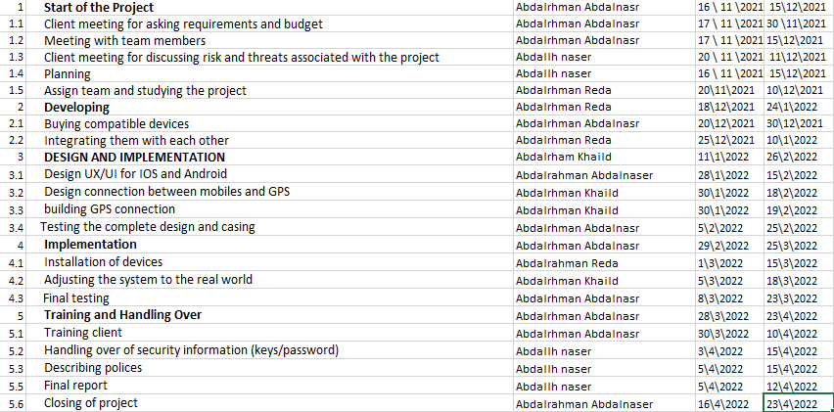
Details about our project
Our project will take 5 months To be ready to use.
Start in 16/11/2021.
ends in 23/4/2022.

Slide 8
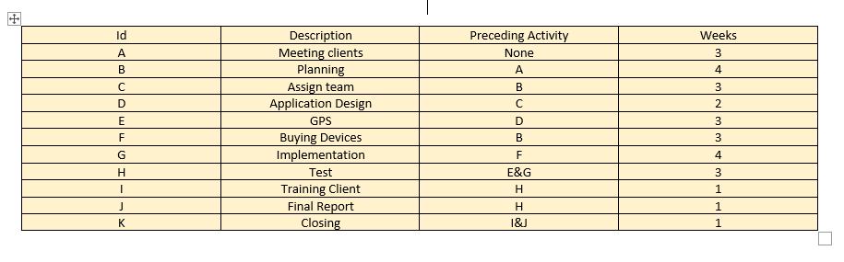
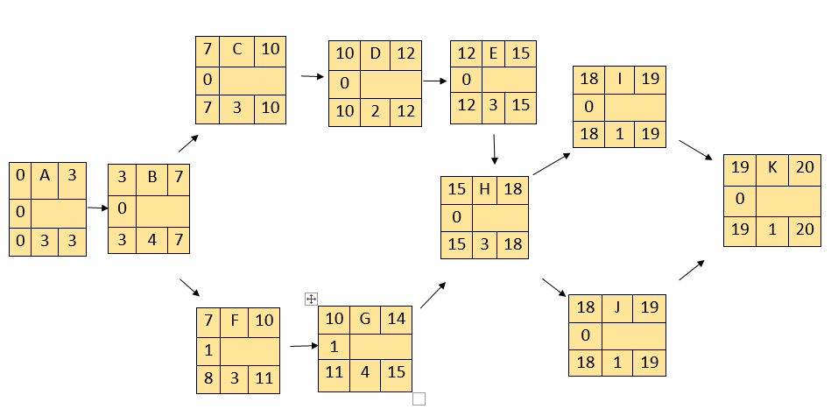
Details about our project
Network

Slide 9
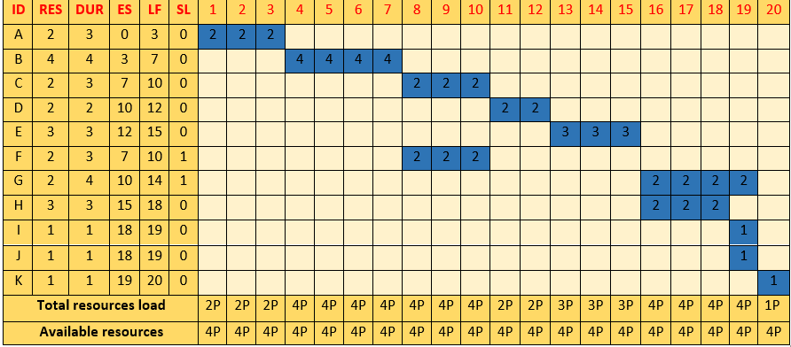
Details about our project
- 4 programmer will build this app(2 android developers, 1 IOS developer, 1 back end developer).

Slide 10
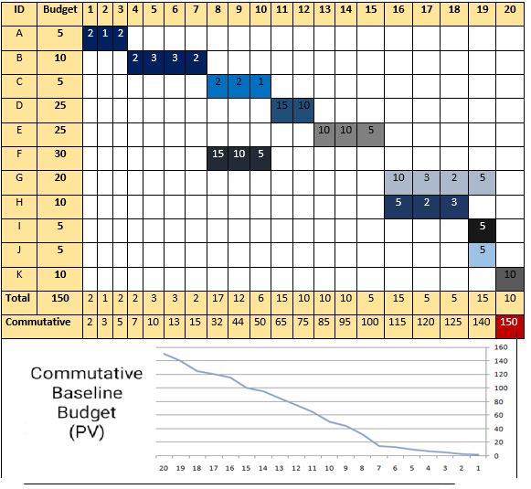
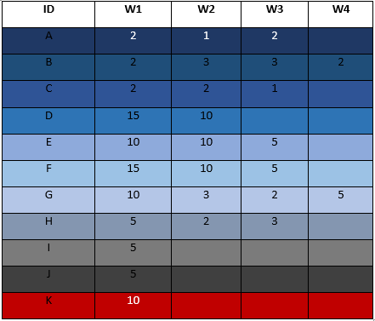
Details about our project
Budget - our project costs 150,000$. - it will be devided during the work as below:

Slide 11
Thanks

